Slide 1

Sustainable Hotel Booking
By VIGNESH K S
Theme: Green Hotel Score

Slide 2
Problem
According to 2021 study, 81% of people survey said they plan to choose sustainable accommodation in future.
1/3rd of Hilton guests research on environmental & social practices.
A 2020 booking.com survey found that 53% of respondents want to travel sustainably in near future.
No/very few platforms providing details of sustainability of hotels.
No way to know how sustainable a hotel is.

Slide 3
Solution?
A easy-to-understandable green score which combines over 30+ data points, uses ML to provide personalized green score.

Slide 4
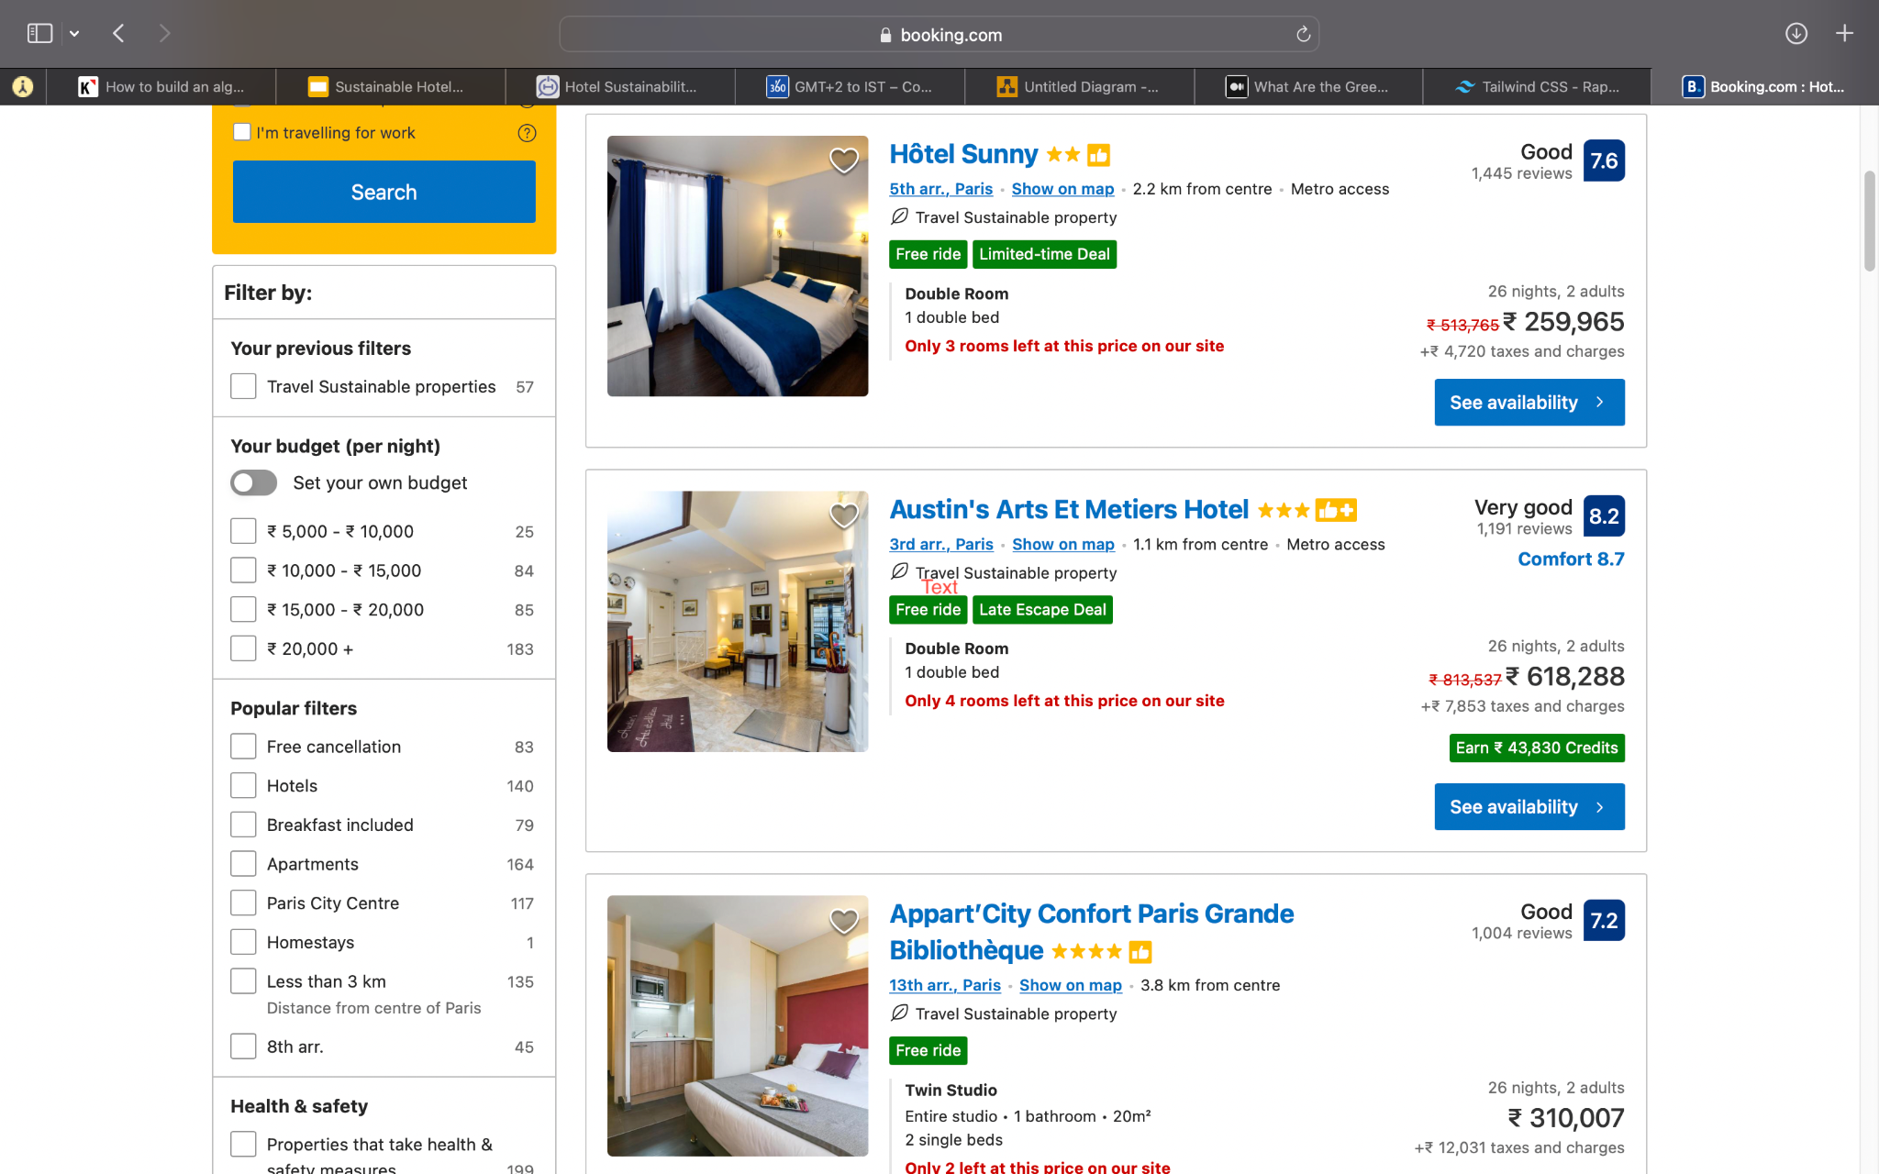
8/10
7/10

Slide 5
How?
Analysed and shortlisted the most used data points by Hotels to determine how sustainable the hotels are.
I have classified them in the high, medium and low impact bucket based on the weightage
Take the input from traveler to get their personal preferences like Vegan,...(may be good to add some more examples)
Feed the data points received from Hotels and input taken from traveler to the custom built algorithm
Compare the result of algorithm with ML model and generate the green score
Display in Travel agency/hotel .. platform in a easy-to understandable way for the user
Usage:
Can be integrated into existing solutions such as Amadeus APIs, or client services such as TripAdvisor, Trivago.

Slide 6
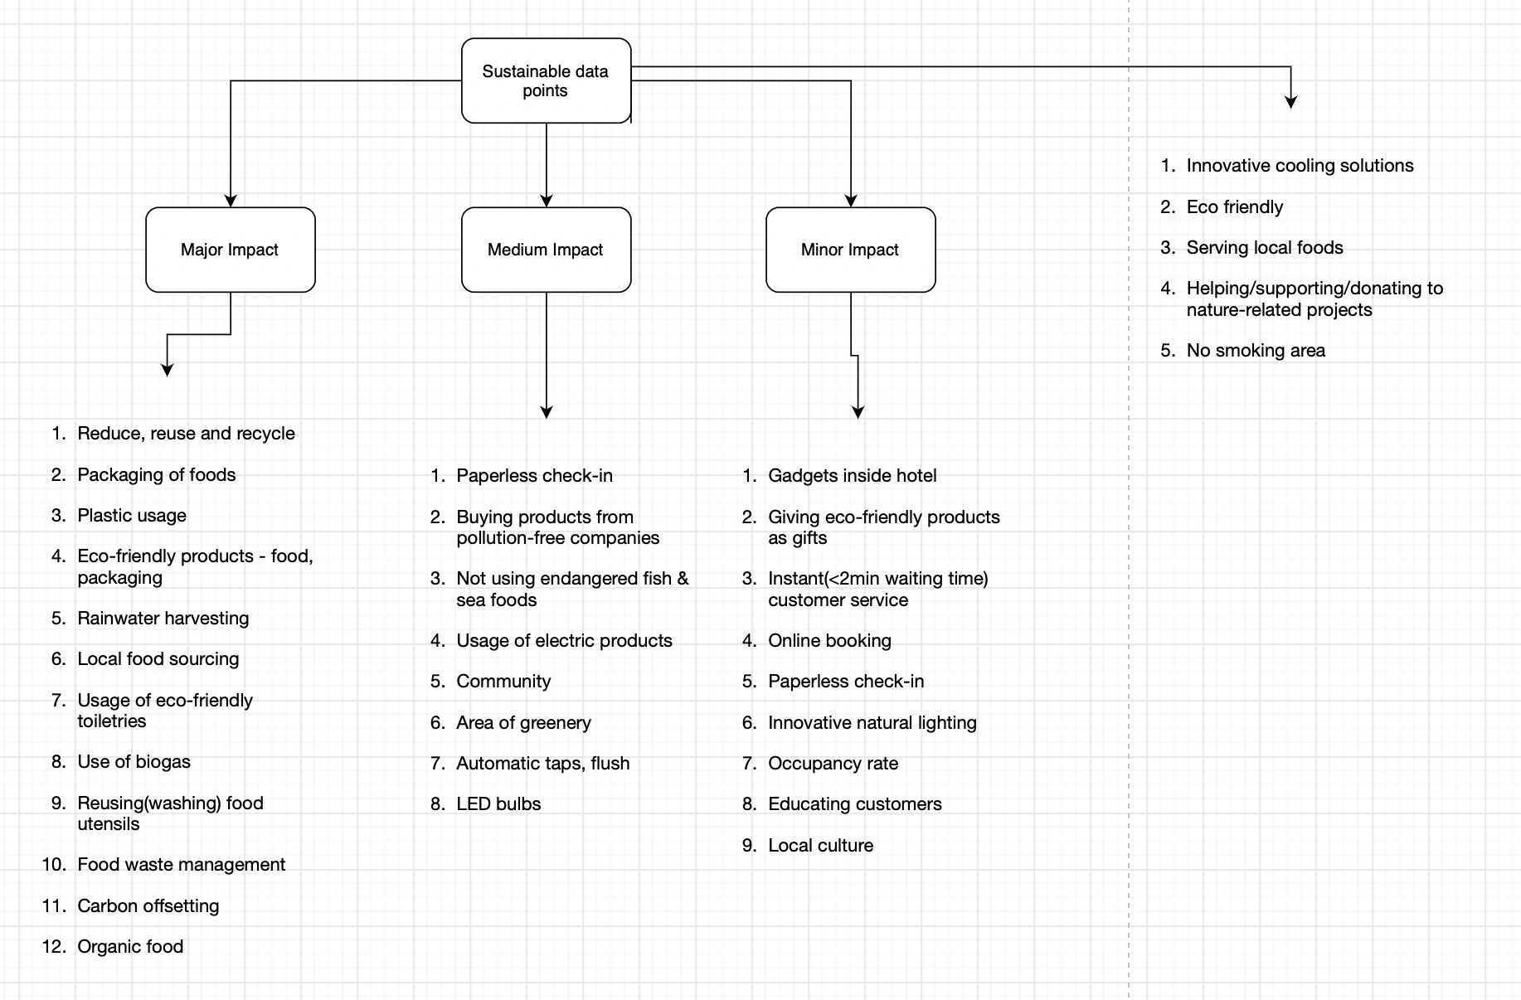
Data points

Slide 7
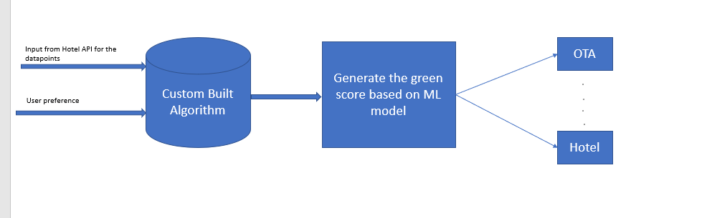
Algorithm & Demo

Slide 8
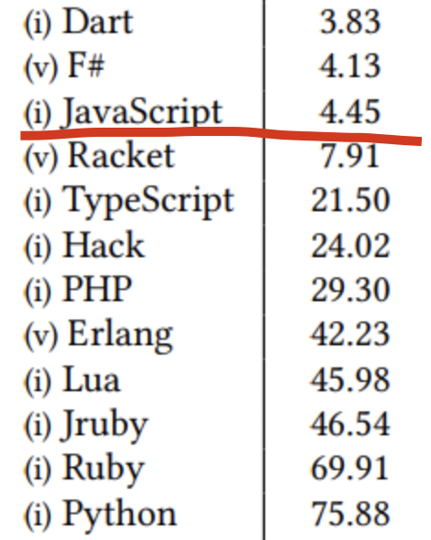
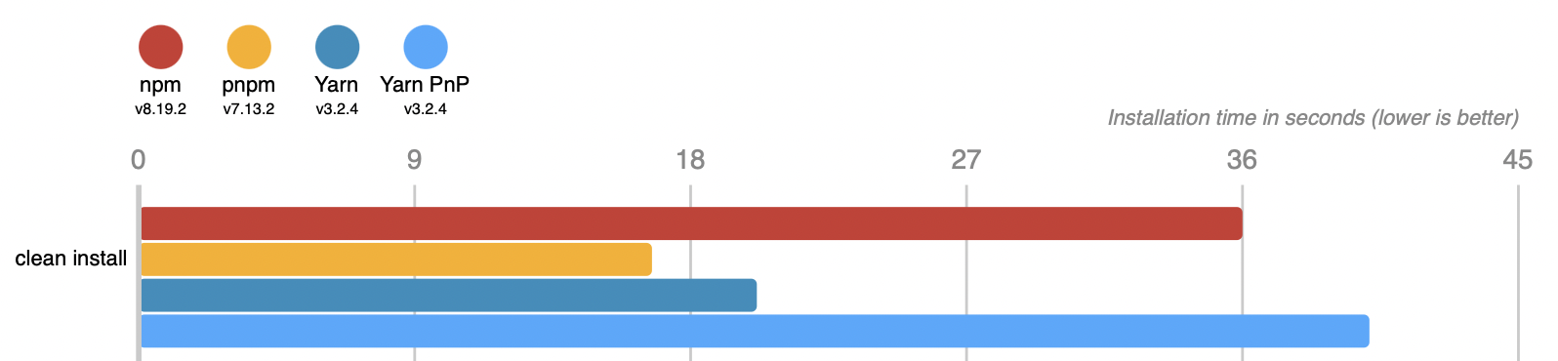
Tech Used
Languages: HTML, JS (15 times energy efficient than Python)
Tech stack
Svelte: Less code(max 4kb), no boilerplate, easy to debug
Tailwind CSS: No switching html & CSS files
pnpm: 2x faster, takes less storage(then alternatives)
3. ML model compiled on server side.
4. Data combined with Amadeus APIs for fast
experience

Slide 9
Why?
Fast
Can be integrated with Amadeus APIs
Highly scalable because of server side running of algorithm & ML model
Highly personalized & increased CTR & conversion rates

Slide 10
References
https://hoteltechreport.com/news/hotel-sustainability-statistics
https://medium.com/codex/what-are-the-greenest-programming-languages-e738774b1957

Slide 11
THANK YOU:)

